Slide 1
Introduction to VPNs

Slide 2
What is a VPN?
» Virtual Private Network
• Private Network
✓Privacy typically obtained via: –
Route privacy (ability to keep your routes separate from the routes of other organizations)
– Data privacy (tunelling, encryption, etc)
• Virtual Network
✓The use/lease of another’s network (typically public Internet) to connect two-or-more of your sites together.

Slide 3
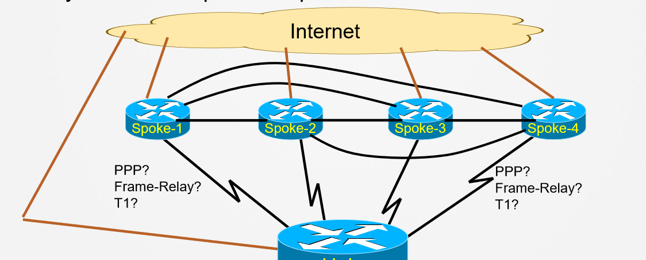
Prior to VPNs
• Before VPNs existed, how could you connect each spoke office to your central office (hub) and maintain data privacy?
• What if you needed spoke-to-spoke connections as well?

Slide 4
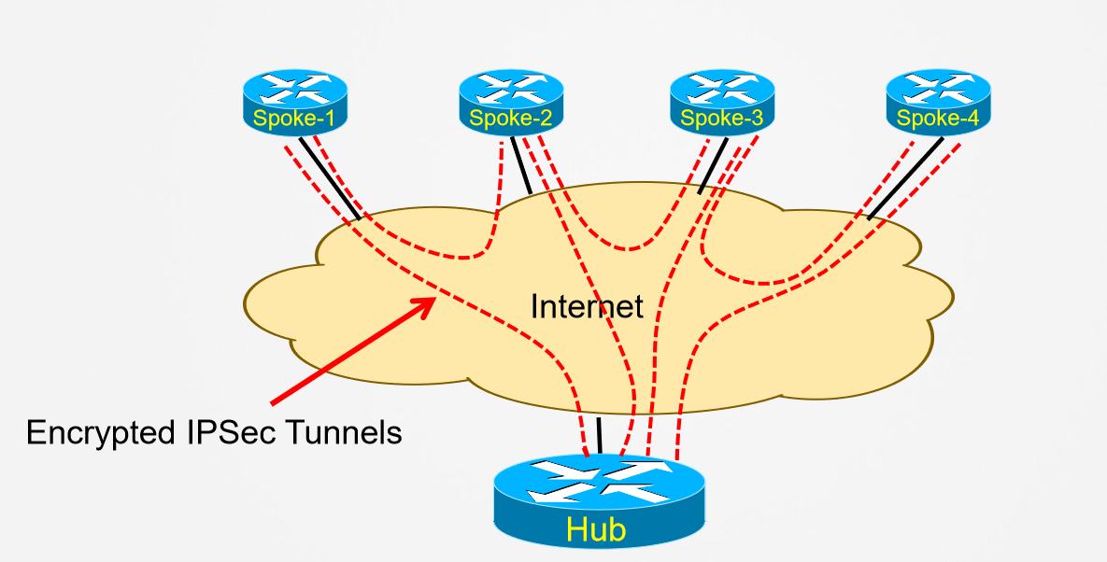
After VPN

Slide 5
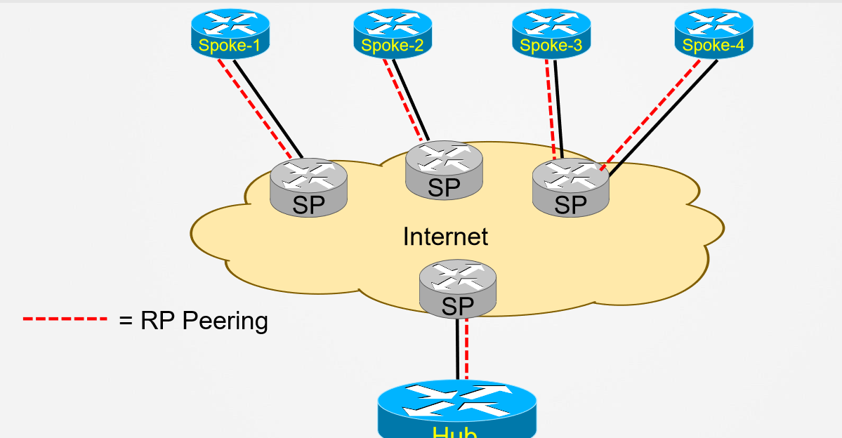
Types of VPNs: Peer-to-Peer

Slide 6
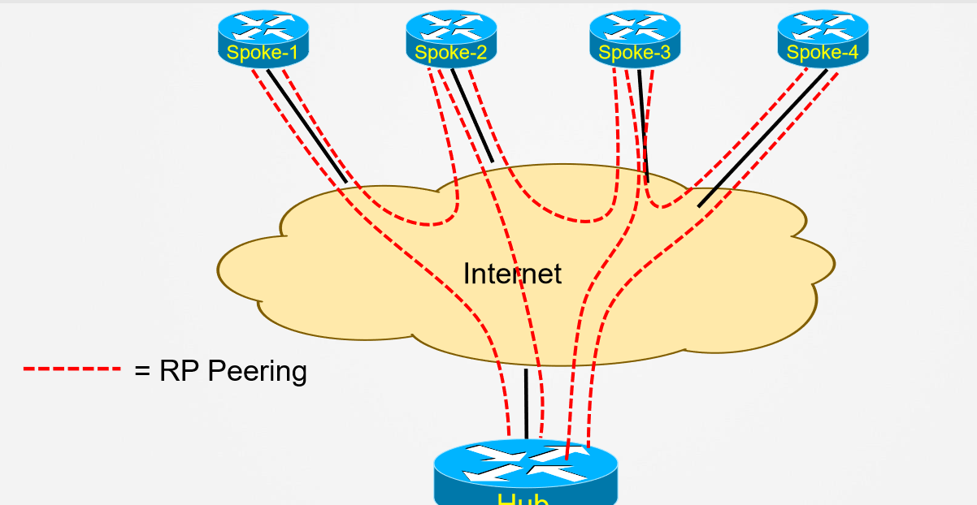
Types of VPNs: Overlay

Slide 7
Site or Client-Side VPN
» All of the examples thus far can be called, “Site-toSite” VPNs because:
• Edge devices (Routers, Firewalls, etc) initiate and terminate the VPN connections between customer sites.
• All traffic from site-to-site is protected by the VPN
» Client VPNs
• Typically initiated by a client (i.e. Laptop, PC, etc)
• Typically terminated by a VPN Gateway (router or server)
• Requires VPN Software to be installed on Client.

Slide 8
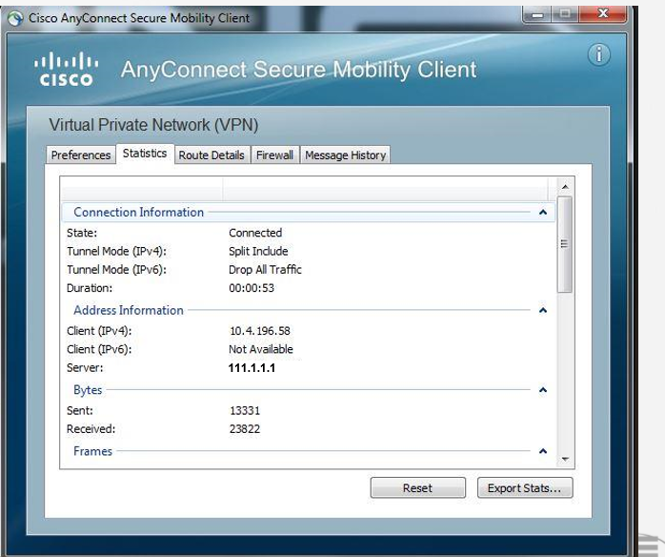
Client-Side VPN Software

Slide 9
Expectations of a typical VPN
» Route exchange privacy
• “There is no way that, when I send IP Routing Updates across this VPN, my routes will be mixed with those of my competitors.”
» Path determination for packets
• “Packets sent from my company will never, accidentally, arrive on the interface of one of my competitors routers.”
» Data Security
• “If anyone is ever able to intercept my packets, I don’t want them able to read, change, or replay those packets.”

Slide 10
Data Security = IPSec
» IPSec = IP Security
» Collection of standardized protocols that provide:
• Confidentiality
• Integrity
• Authentication
• Anti-replay
» Protocols that encompass IPSec are defined in a wide collection of RFCs

